Slide 1


Slide 2
Basics of Functional Dependencies and Normalization for Relational Databases
Dr. Anand Kumar M
Assistant Professor,
NIT-K, Surathkal

Slide 3
Chapter Outline
1 Informal Design Guidelines for Relational Databases
1.1 Semantics of the Relation Attributes
1.2 Redundant Information in Tuples and Update Anomalies
1.3 Null Values in Tuples
1.4 Spurious Tuples
2 Functional Dependencies (FDs)
2.1 Definition of Functional Dependency

Slide 4
Chapter Outline
3 Normal Forms Based on Primary Keys
3.1 Normalization of Relations
3.2 Practical Use of Normal Forms
3.3 Definitions of Keys and Attributes Participating in Keys
3.4 First Normal Form
3.5 Second Normal Form
3.6 Third Normal Form
4 General Normal Form Definitions for 2NF and 3NF (For Multiple Candidate Keys)
5 BCNF (Boyce-Codd Normal Form)

Slide 5
1. Informal Design Guidelines for Relational Databases (1)
What is relational database design?
The grouping of attributes to form "good" relation schemas
Two levels of relation schemas
The logical "user view" level
The storage "base relation" level
Design is concerned mainly with base relations
What are the criteria for "good" base relations?

Slide 6
Informal Design Guidelines for Relational Databases (2)
Data base design approaches
Bottom up design – design by synthesis
Basic relationship among individual attributes
Top down design – design by analysis
Starts with number of grouping attributes

Slide 7
Informal Design Guidelines for Relational Databases
Semantics of the Relation Attributes
Redundant Information in Tuples and Update Anomalies
Null Values in Tuples
Spurious Tuples

Slide 8
1.1 Semantics of the Relational Attributes must be clear
Interpretation of attribute values in a tuple
GUIDELINE 1
Design a relation schema so that it is easy to explain its meaning.
Attributes of different entities (EMPLOYEEs, DEPARTMENTs, PROJECTs) should not be mixed in the same relation
Only foreign keys should be used to refer to other entities
Bottom Line: Design a schema that can be explained easily relation by relation. The semantics of attributes should be easy to interpret.

Slide 9
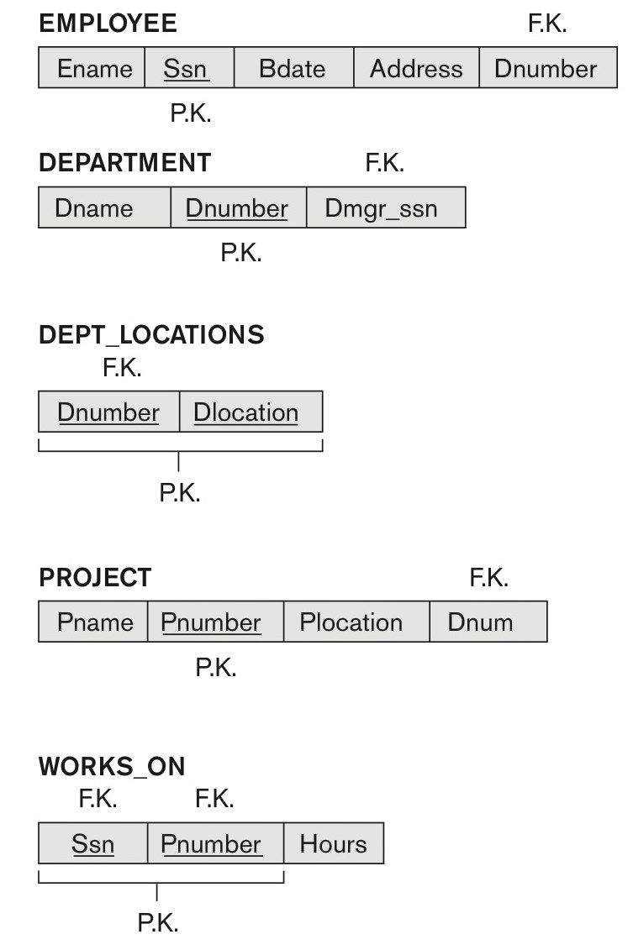
Figure 14.1 A simplified COMPANY relational database schema
Figure 14.1 A simplified COMPANY relational database schema.

Slide 10
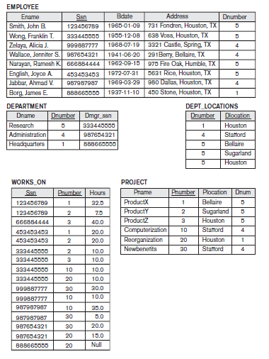

Slide 11
1.2 Redundant Information in Tuples and Update Anomalies
Information is stored redundantly
Wastes storage
Causes problems with update anomalies
Insertion anomalies
Deletion anomalies
Modification anomalies

Slide 12
EXAMPLE OF AN INSERT ANOMALY
Consider the relation:
EMP_DEPT, EMP_PRO
Insert Anomaly:
Consistency (tuples of department)
Cannot insert a project unless an employee is assigned to it.
Conversely
Cannot insert an employee unless an he/she is assigned to a project.

Slide 13
EXAMPLE OF A DELETE ANOMALY
Consider the relation:
EMP_PROJ(Emp#, Proj#, Ename, Pname, No_hours)
Delete Anomaly:
When a project is deleted, it will result in deleting all the employees who work on that project.
Alternately, if an employee is the sole employee on a project, deleting that employee would result in deleting the corresponding project.

Slide 14
EXAMPLE OF AN Modification ANOMALY
Consider the relation:
EMP_PROJ(Emp#, Proj#, Ename, Pname, No_hours)
Update Anomaly:
Changing the manager of dept 5 – we must update the tuples of all the emp who work in the dept.

Slide 15
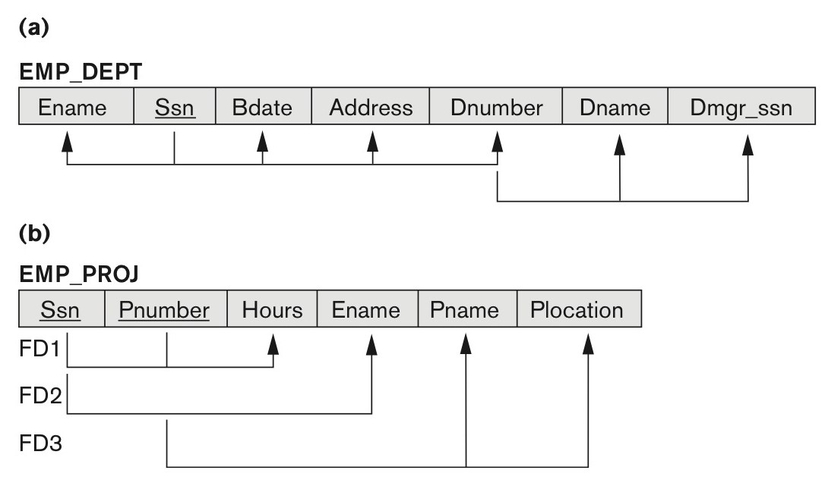
Figure 14.3 Two relation schemas suffering from update anomalies
Figure 14.3
Two relation schemas suffering from update anomalies. (a) EMP_DEPT and (b) EMP_PROJ.

Slide 16
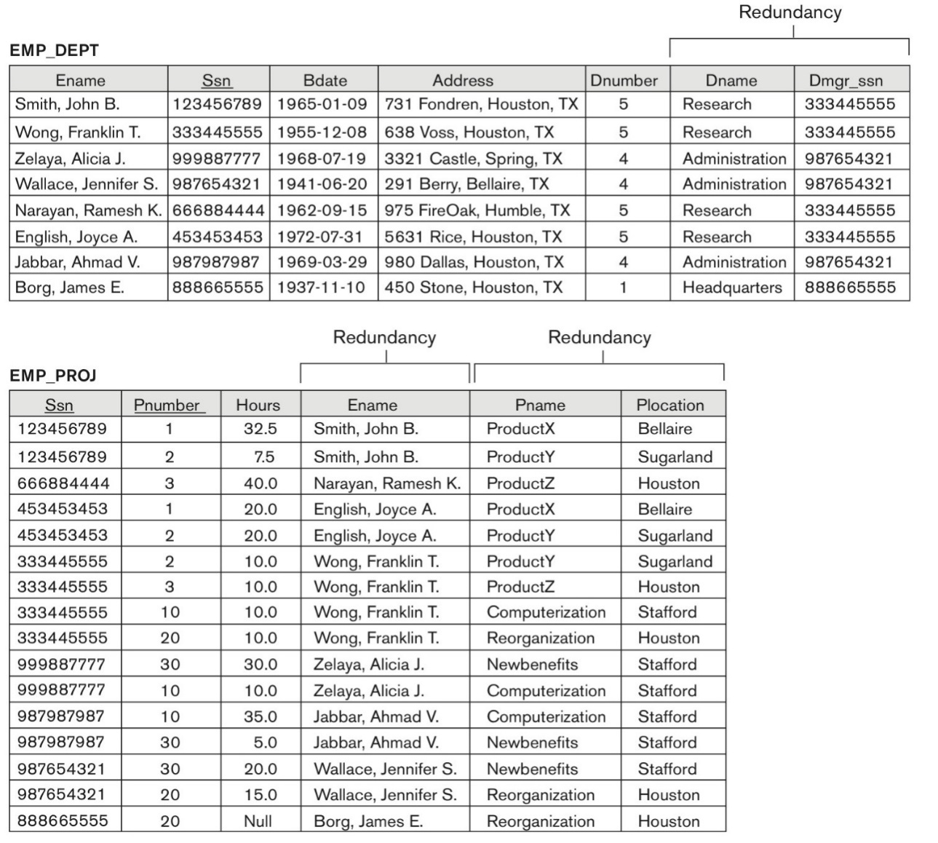
Figure 14.4 Sample states for EMP_DEPT and EMP_PROJ
Figure 14.4
Sample states for EMP_DEPT and EMP_PROJ resulting from applying NATURAL JOIN to the relations in Figure 14.2. These may be stored as base relations for performance reasons.

Slide 17
Guideline for Redundant Information in Tuples and Update Anomalies
GUIDELINE 2:
Design a schema that does not suffer from the insertion, deletion and update anomalies.
If there are any anomalies present, then note them so that applications can be made to take them into account.

Slide 18
1.3 Null Values in Tuples
Reasons for nulls:
Attribute not applicable or invalid
Attribute value unknown
Value known to exist, but unavailable
GUIDELINE 3:
Relations should be designed such that their tuples will have as few NULL values as possible
Attributes that are NULL frequently could be placed in separate relations (with the primary key)

Slide 19
1.3 Null Values in Tuples
Example: only 10 percent of emp have individual offices – instead of including the attribute office number in EMP relation, new relation EMP_OFF(Essn,Offnum) can be created

Slide 20
1.4 Generation of Spurious Tuples – avoid at any cost
Bad designs for a relational database may result in erroneous results for certain JOIN operations
GUIDELINE 4:
The relations should be designed to satisfy the equality conditions on attributes that are (PK,FK).
No spurious tuples should be generated by doing a natural-join of any relations.

Slide 21
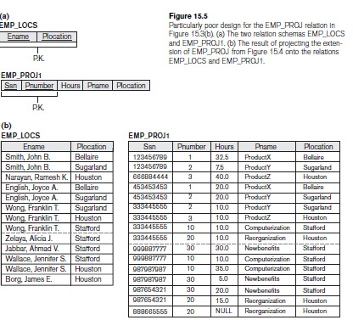
Spurious Tuples (2)

Slide 22
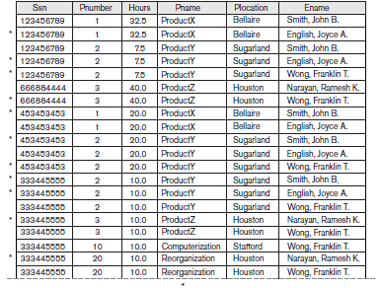
Spurious Tuples (3)

Slide 23
Functional Dependencies
Functional dependencies (FDs)
Are used to specify formal measures of the "goodness" of relational designs
FD is a constraint b/w two set of attributes from the database.
A set of attributes X functionally determines a set of attributes Y if the value of X determines a unique value for Y

Slide 24
2.1 Defining Functional Dependencies
X  Y holds if whenever two tuples have the same value for X, they must have the same value for Y
For any two tuples t1 and t2 in any relation instance r(R): If t1[X]=t2[X], then t1[Y]=t2[Y]
X  Y in R specifies a constraint on all relation instances r(R)
Written as X  Y; can be displayed graphically on a relation schema as in Figures. ( denoted by the arrow: ).
FDs are derived from the real-world constraints on the attributes

Slide 25
Examples of FD constraints (1)
Social security number determines employee name
SSN  ENAME
Project number determines project name and location
PNUMBER  {PNAME, PLOCATION}
Employee ssn and project number determines the hours per week that the employee works on the project
{SSN, PNUMBER}  HOURS

Slide 26
Examples of FD constraints (2)
An FD is a property of the attributes in the schema R
The constraint must hold on every relation instance r(R)
If K is a key of R, then K functionally determines all attributes in R
(since we never have two distinct tuples with t1[K]=t2[K])

Slide 27
Defining FDs from instances
Note that in order to define the FDs, we need to understand the meaning of the attributes involved and the relationship between them.
Certain FD are possible without referring to a specific relation.
{State, License_Plate_number} -> Name
FD cannot be inferred automatically from a given relation. It must be defined by experts who knows the semantics of the Attributes of relation.

Slide 28
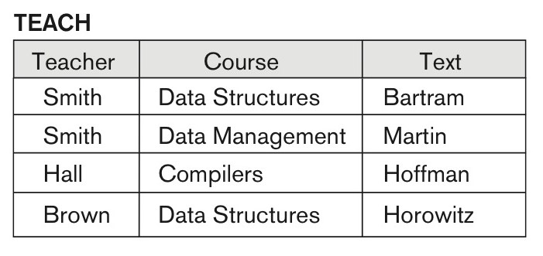
Ruling Out FDs
Note that given the state of the TEACH relation, we can say that the FD: Text → Course may exist. However, the FDs Teacher → Course, Teacher → Text and
Couse → Text are ruled out.

Slide 29
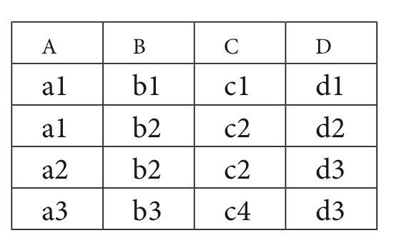
What FDs may exist?
A relation R(A, B, C, D) with its extension.
Which FDs may exist in this relation?

Slide 30
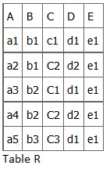
Consider the following table of data r(R) of the relation schema R(ABCDE) shown in Table. Functional dependency example, by A. Watt
As you look at this table, ask yourself: What kind of dependencies can we observe among the attributes in Table R? Since the values of A are unique (a1, a2, a3, etc.), it follows from the FD definition that:
A → B, A → C, A → D, A → E
It also follows that A →BC (or any other subset of ABCDE).
This can be summarized as A →BCDE.
From our understanding of primary keys, A is a primary key.
Since the values of E are always the same (all e1), it follows that:
A → E, B → E, C → E, D → E

Slide 31
2.2 Inference Rules for FDs (1)
Given a set of FDs F, we can infer additional FDs .
Depno->Dname , Dname->Mgr_name
Depno→Mgr_name
Armstrong's inference rules:
IR1. (Reflexive) If Y subset-of X, then X -> Y
IR2. (Augmentation) If X -> Y, then XZ -> YZ
(Notation: XZ stands for X U Z)
IR3. (Transitive) If X -> Y and Y -> Z, then X -> Z
These are rules hold and all other rules that hold can be deduced from these

Slide 32
Inference Rules for FDs (2)
Some additional inference rules that are useful:
Decomposition: If X -> YZ, then X -> Y and X -> Z
Union: If X -> Y and X -> Z, then X -> YZ
Psuedotransitivity: If X -> Y and WY -> Z, then WX -> Z

Slide 33
Inference Rules for FDs (3)
Closure of a set F of FDs is the set F⁺ of all FDs that can be inferred from F
The set of all dependencies that include F as well as all dependencies that can be inferred from F is called closure of F (F+).
Closure of a set of attributes X with respect to F is the set X⁺ of all attributes that are functionally determined by X
X⁺ can be calculated by repeatedly applying IR1, IR2, IR3 using the FDs in F

Slide 34
2.3 Equivalence of Sets of FDs
Two sets of FDs F and G are equivalent if:
Every FD in F can be inferred from G, and
Every FD in G can be inferred from F
Hence, F and G are equivalent if F⁺ =G⁺
Definition (Covers):
F covers G if every FD in G can be inferred from F
(i.e., if G⁺ subset-of F⁺)
F and G are equivalent if F covers G and G covers F

Slide 35
Minimal Sets of FDs
Every set of FDs has an equivalent minimal set
There can be several equivalent minimal sets
There is no simple algorithm for computing a minimal set of FDs that is equivalent to a set F of FDs
To synthesize a set of relations, we assume that we start with a set of dependencies that is a minimal set.

Slide 36
Normalization

Slide 37
3 Normal Forms Based on Primary Keys
3.1 Normalization of Relations
3.2 Practical Use of Normal Forms
3.3 Definitions of Keys and Attributes Participating in Keys
3.4 First Normal Form
3.5 Second Normal Form
3.6 Third Normal Form

Slide 38
3.1 Normalization of Relations (1)
Normalization:
The process of decomposing unsatisfactory "bad" relations by breaking up their attributes into smaller relations
Normal form:
Condition using keys and FDs of a relation to certify whether a relation schema is in a particular normal form

Slide 39
Normalization of Relations
Relational design by analysis
Relational design by synthesis
Normalization of Data:
The process of analyzing the given relation schema based on their FDs and PK to achieve the desired properties.
Minimizing redundancy
Minimizing the modification anomalies

Slide 40
Normalization of Relations (2)
1NF
2NF, 3NF, BCNF
based on keys and FDs of a relation schema
4NF
based on keys, multi-valued dependencies : MVDs;
5NF
based on keys, join dependencies : JDs
Additional properties may be needed to ensure a good relational design (lossless join, dependency preservation)

Slide 41
3.2 Practical Use of Normal Forms
Normalization is carried out in practice so that the resulting designs are of high quality and meet the desirable properties
The practical utility of these normal forms becomes questionable when the constraints on which they are based are hard to understand or to detect
The database designers need not normalize to the highest possible normal form
(usually up to 3NF and BCNF. 4NF rarely used in practice.)
Denormalization:
Denormalization is the process of trying to improve the read performance of a database, at the expense of losing some write performance, by adding redundant copies of data or by grouping data.

Slide 42
3.3 Definitions of Keys and Attributes Participating in Keys (1)
A superkey of a relation schema R = {A1, A2, ...., An} is a set of attributes S subset-of R with the property that no two tuples t1 and t2 in any legal relation state r of R will have t1[S] = t2[S]
A key K is a superkey with the additional property that removal of any attribute from K will cause K not to be a superkey any more.
Key has to be minimal
{Essn} is a key of EMP table, whereas {Essn},{Essn,Ename},{Essn, Ename,Bdate} and any set of attributes that includes Essn are all Super Keys

Slide 43
Definitions of Keys and Attributes Participating in Keys (2)
If a relation schema has more than one key, each is called a candidate key.
One of the candidate keys is arbitrarily designated to be the primary key, and the others are called secondary keys.
A Prime attribute must be a member of some candidate key
A Nonprime attribute is not a prime attribute—that is, it is not a member of any candidate key.

Slide 44
3.4 First Normal Form
Disallows
composite attributes
multivalued attributes
nested relations; attributes whose values for an individual tuple are non-atomic
Single atomic value only permitted
Considered to be part of the definition of a relation
Most RDBMSs allow only those relations to be defined that are in First Normal Form

Slide 45
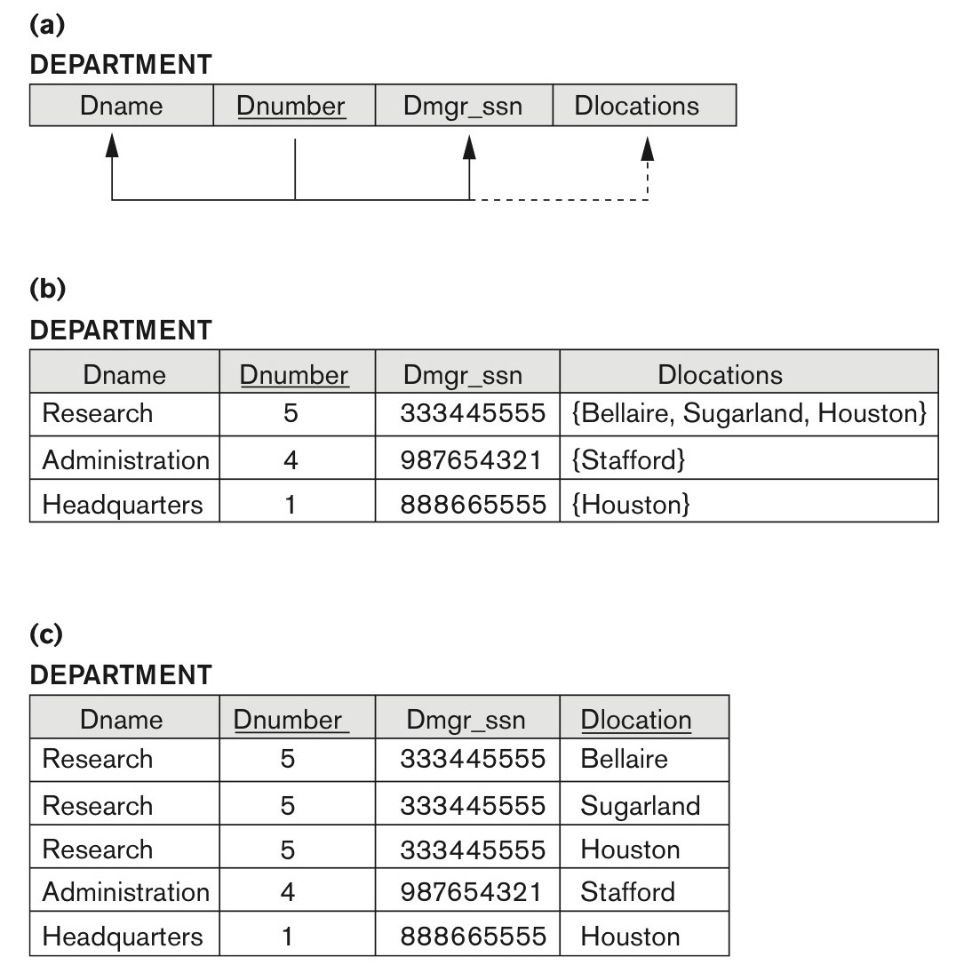
Figure 14.9 Normalization into 1NF
Figure 14.9
Normalization into 1NF. (a) A relation schema that is not in 1NF. (b) Sample state of relation DEPARTMENT. (c) 1NF version of the same relation with redundancy.

Slide 46
Three ways - First Normal Form
Remove the attr Dloc that violates 1NF and place it in a separate relation Dept_LOC. The PK is the combination of {Dloc and Dnum}.
Expand to the separate tuple- PK is combination of {Dloc and Dnum}.
If the max no of values are known – say example 3- Replace the Dloc to three atomic attributes Dloc1,Dloc2,Dloc3

Slide 47

Three ways - First Normal Form
Remove the attr Dloc that violates 1NF and place it in a separate relation Dept_LOC. The PK is the combination of {Dloc and Dnum}.
Expand to the separate tuple- PK is combination of {Dloc and Dnum}.
If the max no of values are known – say example 3- Replace the Dloc to three atomic attributes Dloc1,Dloc2,Dloc3
Redundancy
NULL values, Query
List the dept that have “houston” as one of the locations

Slide 48

Figure 14.10 Normalizing nested relations into 1NF
Figure 14.10
Normalizing nested relations into 1NF. (a) Schema of the EMP_PROJ relation with a nested relation attribute PROJS. (b) Sample extension of the EMP_PROJ relation showing nested relations within each tuple. (c) Decomposition of EMP_PROJ into relations EMP_PROJ1 and EMP_PROJ2 by propagating the primary key.

Slide 49
3.5 Second Normal Form (1)
Uses the concepts of FDs, primary key
Definitions
Prime attribute: An attribute that is member of the primary key K
Full functional dependency: a FD Y -> Z where removal of any attribute from Y means the FD does not hold any more
Examples:
{SSN, PNUMBER} -> HOURS is a full FD since neither SSN -> HOURS nor PNUMBER -> HOURS hold
{SSN, PNUMBER} -> ENAME is not a full FD (it is called a partial dependency ) since SSN -> ENAME also holds

Slide 50
Second Normal Form
SSN, PNUMBER} -> HOURS is a full FD since neither SSN -> HOURS nor PNUMBER -> HOURS hold
{SSN, PNUMBER} –
> ENAME is not a full FD (it is called a partial dependency ) since SSN -> ENAME also holds

Slide 51
Second Normal Form (2)
A relation schema R is in second normal form (2NF) if every non-prime attribute A in R is fully functionally dependent on the primary key
R can be decomposed into 2NF relations via the process of 2NF normalization or “second normalization”

Slide 52
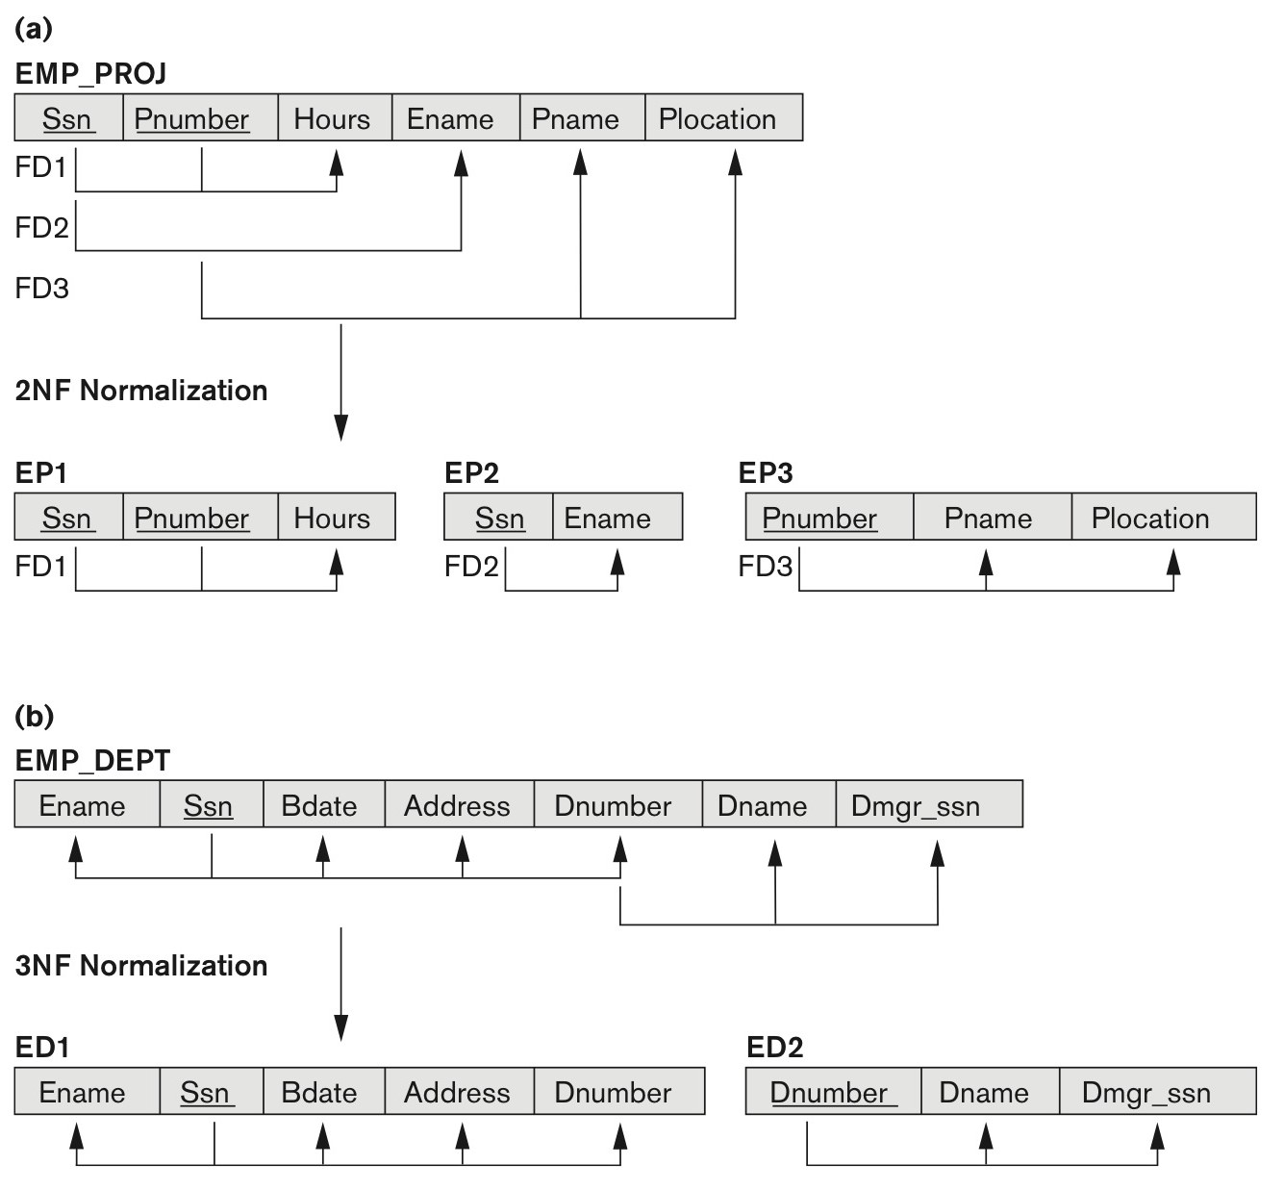
Figure 14.11 Normalizing into 2NF and 3NF
Figure 14.11
Normalizing into 2NF and 3NF. (a) Normalizing EMP_PROJ into 2NF relations. (b) Normalizing EMP_DEPT into 3NF relations.

Slide 53
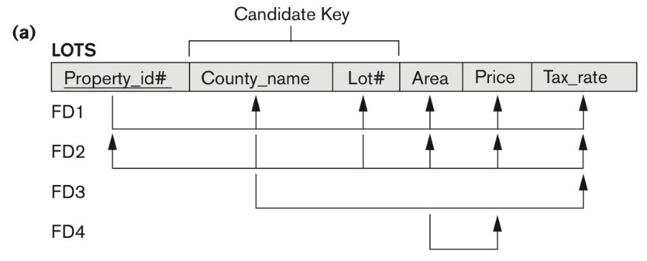
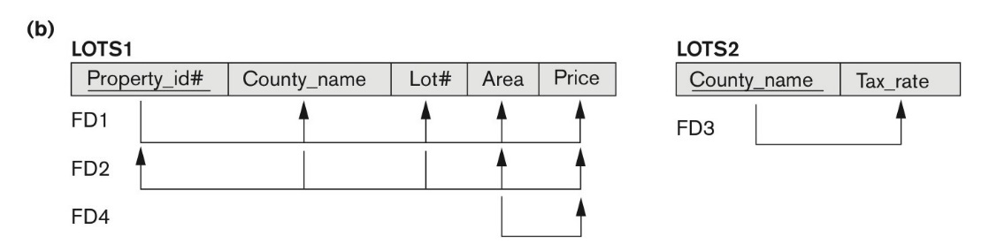
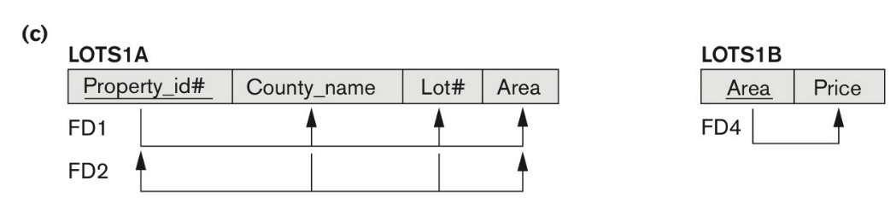
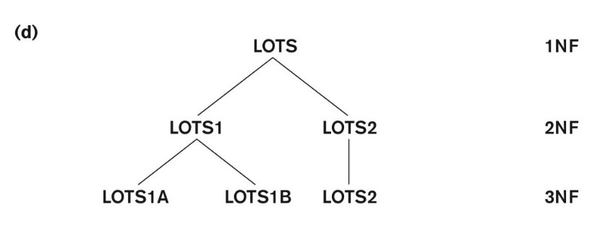
Figure 14.12 Normalization into 2NF and 3NF
Figure 14.12 Normalization into 2NF and 3NF. (a) The LOTS relation with its functional dependencies FD1 through FD4.
(b) Decomposing into the 2NF relations LOTS1 and LOTS2. (c) Decomposing LOTS1 into the 3NF relations LOTS1A and LOTS1B. (d) Progressive normalization of LOTS into a 3NF design.

Slide 54
3.6 Third Normal Form (1)
Definition:
Transitive functional dependency: a FD X -> Z that can be derived from two FDs X -> Y and Y -> Z
Examples:
SSN -> DMGRSSN is a transitive FD
Since SSN -> DNUMBER and DNUMBER -> DMGRSSN hold
SSN -> ENAME is non-transitive
Since there is no set of attributes X where SSN -> X and X -> ENAME

Slide 55
Third Normal Form (2)
A relation schema R is in third normal form (3NF) if it is in 2NF and no non-prime attribute A in R is transitively dependent on the primary key
R can be decomposed into 3NF relations via the process of 3NF normalization
NOTE:
In X -> Y and Y -> Z, with X as the primary key, we consider this a problem only if Y is not a candidate key.
When Y is a candidate key, there is no problem with the transitive dependency .
E.g., Consider EMP (SSN, Emp#, Salary ).
Here, SSN -> Emp# -> Salary and Emp# is a candidate key.

Slide 56
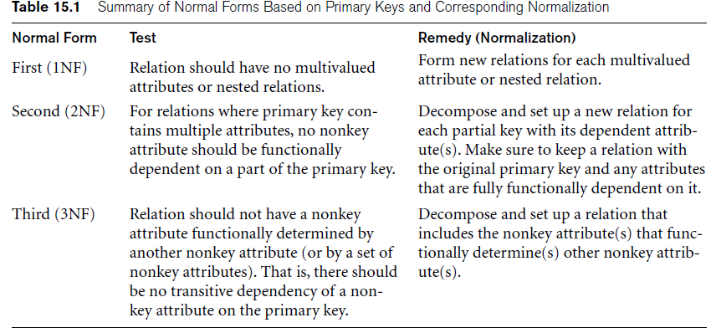

Slide 57
Normal Forms Defined Informally
1st normal form
All attributes depend on the key
2nd normal form
All attributes depend on the whole key
3rd normal form
All attributes depend on nothing but the key

Slide 58
4. General Normal Form Definitions (For Multiple Keys) (1)
The above definitions consider the primary key only
The following more general definitions take into account relations with multiple candidate keys
Any attribute involved in a candidate key is a prime attribute
All other attributes are called non-prime attributes.

Slide 59
4.1 General Definition of 2NF (For Multiple Candidate Keys)
A relation schema R is in second normal form (2NF) if every non-prime attribute A in R is fully functionally dependent on every key of R
In Figure 14.12 the FD
County_name → Tax_rate violates 2NF.
So second normalization converts LOTS into
LOTS1 (Property_id#, County_name, Lot#, Area, Price)
LOTS2 ( County_name, Tax_rate)

Slide 60
Figure 14.12 Normalization into 2NF and 3NF
Figure 14.12 Normalization into 2NF and 3NF. (a) The LOTS relation with its functional dependencies FD1 through FD4.
(b) Decomposing into the 2NF relations LOTS1 and LOTS2. (c) Decomposing LOTS1 into the 3NF relations LOTS1A and LOTS1B. (d) Progressive normalization of LOTS into a 3NF design.

Slide 61
4.2 General Definition of Third Normal Form
Definition:
Superkey of relation schema R - a set of attributes S of R that contains a key of R
A relation schema R is in third normal form (3NF) if whenever a FD X → A holds in R, then either:
(a) X is a superkey of R, or
(b) A is a prime attribute of R
LOTS1 relation violates 3NF because
Area → Price ; and Area is not a superkey in LOTS1. (see Figure 14.12).

Slide 62
4.3 Interpreting the General Definition of Third Normal Form (2)
ALTERNATIVE DEFINITION of 3NF: We can restate the definition as:
A relation schema R is in third normal form (3NF) if every non-prime attribute in R meets both of these conditions:
It is fully functionally dependent on every key of R
It is non-transitively dependent on every key of R
Note that stated this way, a relation in 3NF also meets the requirements for 2NF.

Slide 63
5. BCNF (Boyce-Codd Normal Form)
A relation schema R is in Boyce-Codd Normal Form (BCNF) if whenever an FD X → A holds in R, then X is a superkey of R
Each normal form is strictly stronger than the previous one
Every 2NF relation is in 1NF
Every 3NF relation is in 2NF
Every BCNF relation is in 3NF
There exist relations that are in 3NF but not in BCNF
Hence BCNF is considered a stronger form of 3NF
The goal is to have each relation in BCNF (or 3NF)

Slide 64
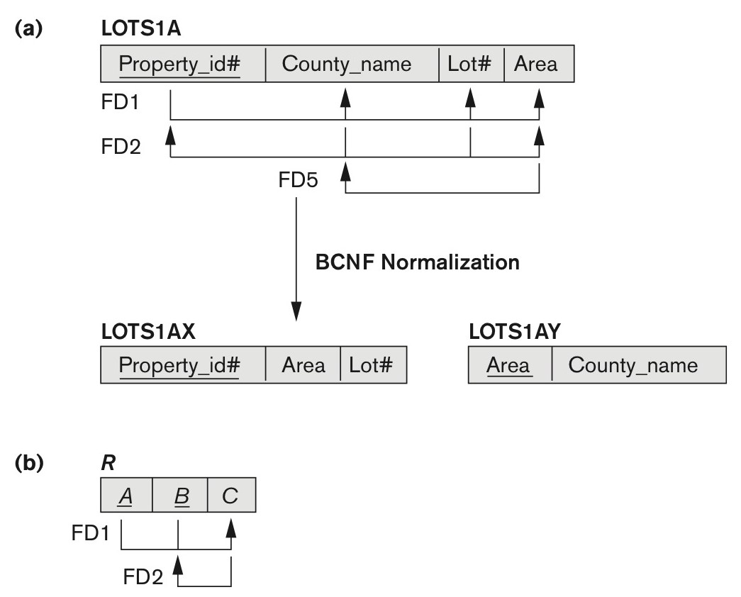
Figure 14.13 Boyce-Codd normal form
Figure 14.13
Boyce-Codd normal form. (a) BCNF normalization of LOTS1A with the functional dependency FD2 being lost in the decomposition. (b) A schematic relation with FDs; it is in 3NF, but not in BCNF due to the f.d. C → B.

Slide 65
Chapter Summary
Informal Design Guidelines for Relational Databases
Functional Dependencies (FDs)
Normal Forms (1NF, 2NF, 3NF)Based on Primary Keys
General Normal Form Definitions of 2NF and 3NF (For Multiple Keys)
BCNF (Boyce-Codd Normal Form)
Fourth and Fifth Normal Forms

